Slide 1
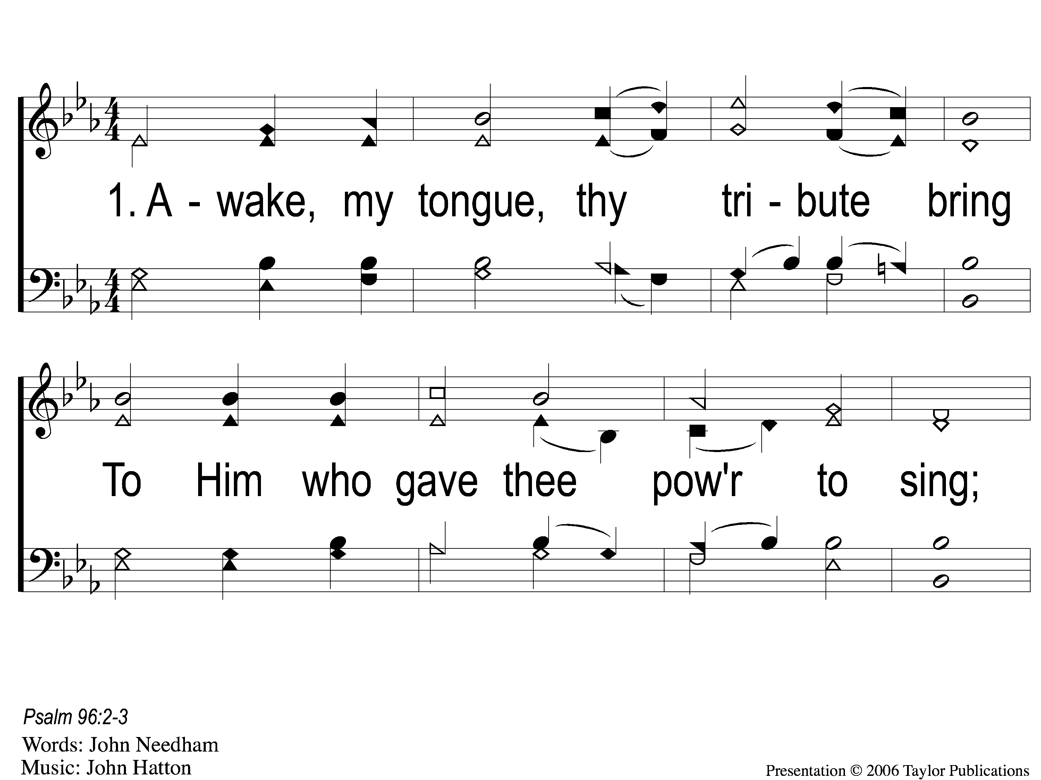
1-1 Awake My Tongue Thy Tribute Bring
Awake, My Tongue, Thy Tribute Bring
161

Slide 2
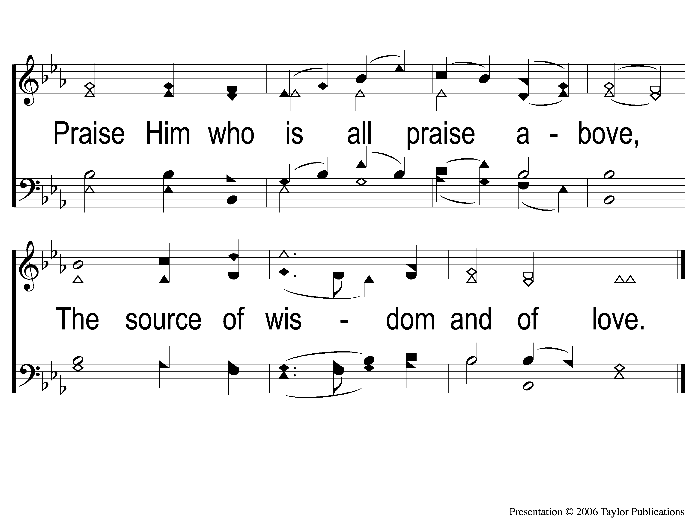
1-2 Awake My Tongue Thy Tribute Bring
Awake, My Tongue, Thy Tribute Bring
161

Slide 3
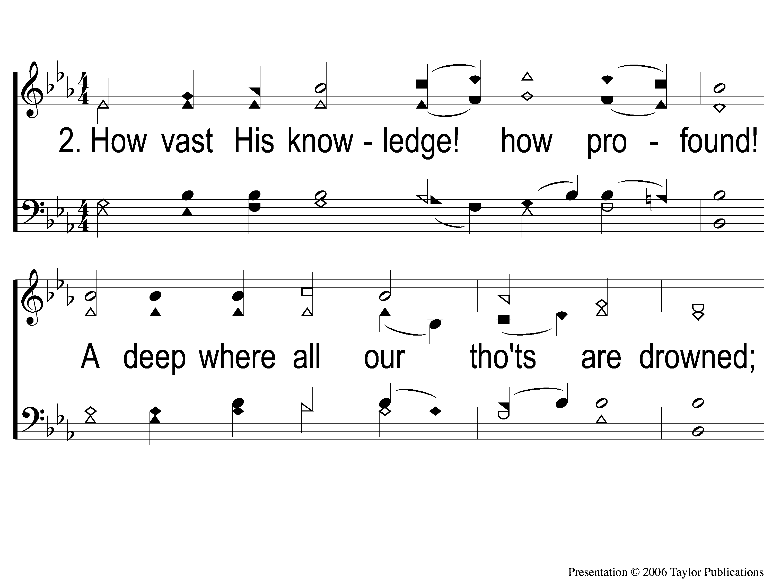
2-1 Awake My Tongue Thy Tribute Bring
Awake, My Tongue, Thy Tribute Bring
161

Slide 4
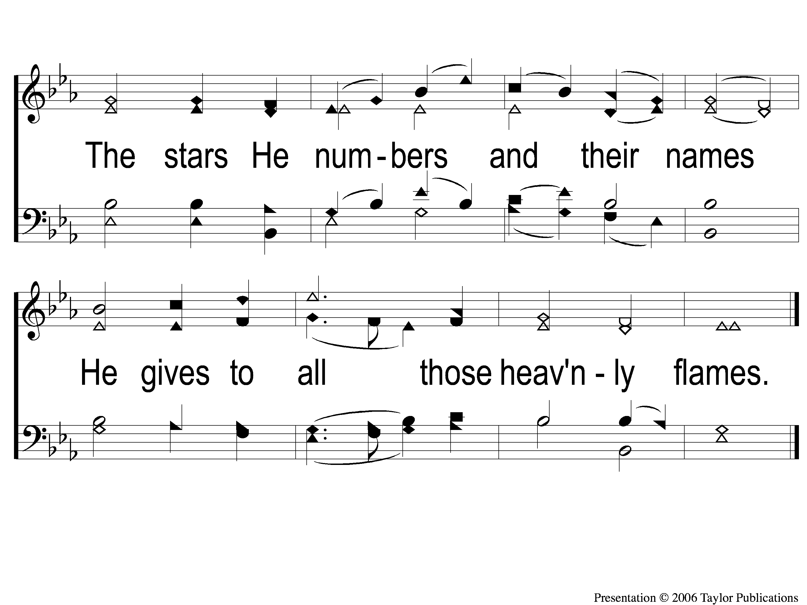
2-2 Awake My Tongue Thy Tribute Bring
Awake, My Tongue, Thy Tribute Bring
161

Slide 5
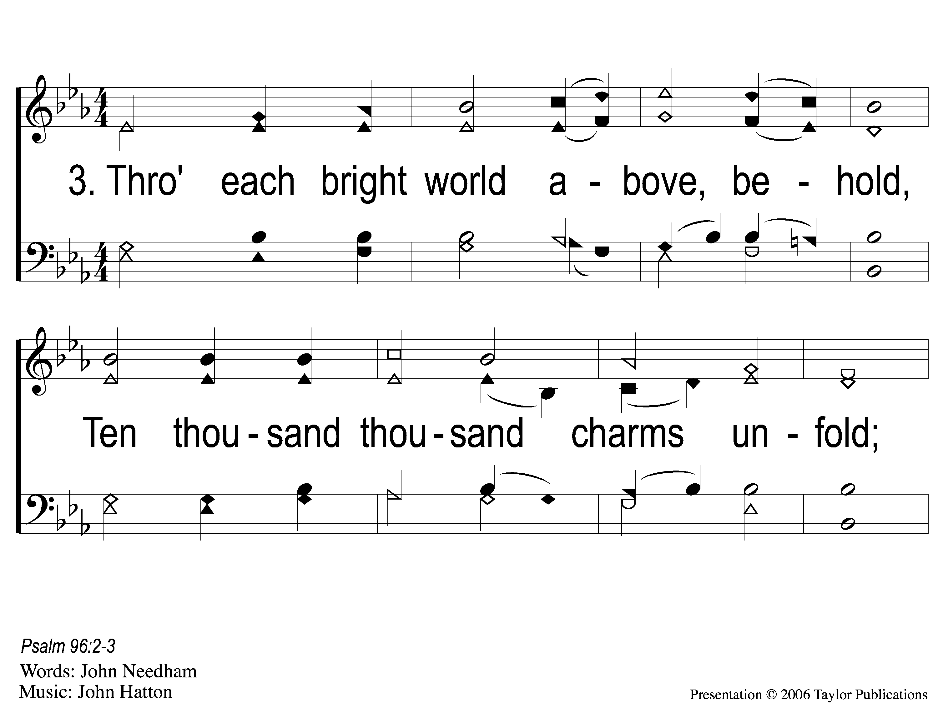
3-1 Awake My Tongue Thy Tribute Bring
Awake, My Tongue, Thy Tribute Bring
161

Slide 6
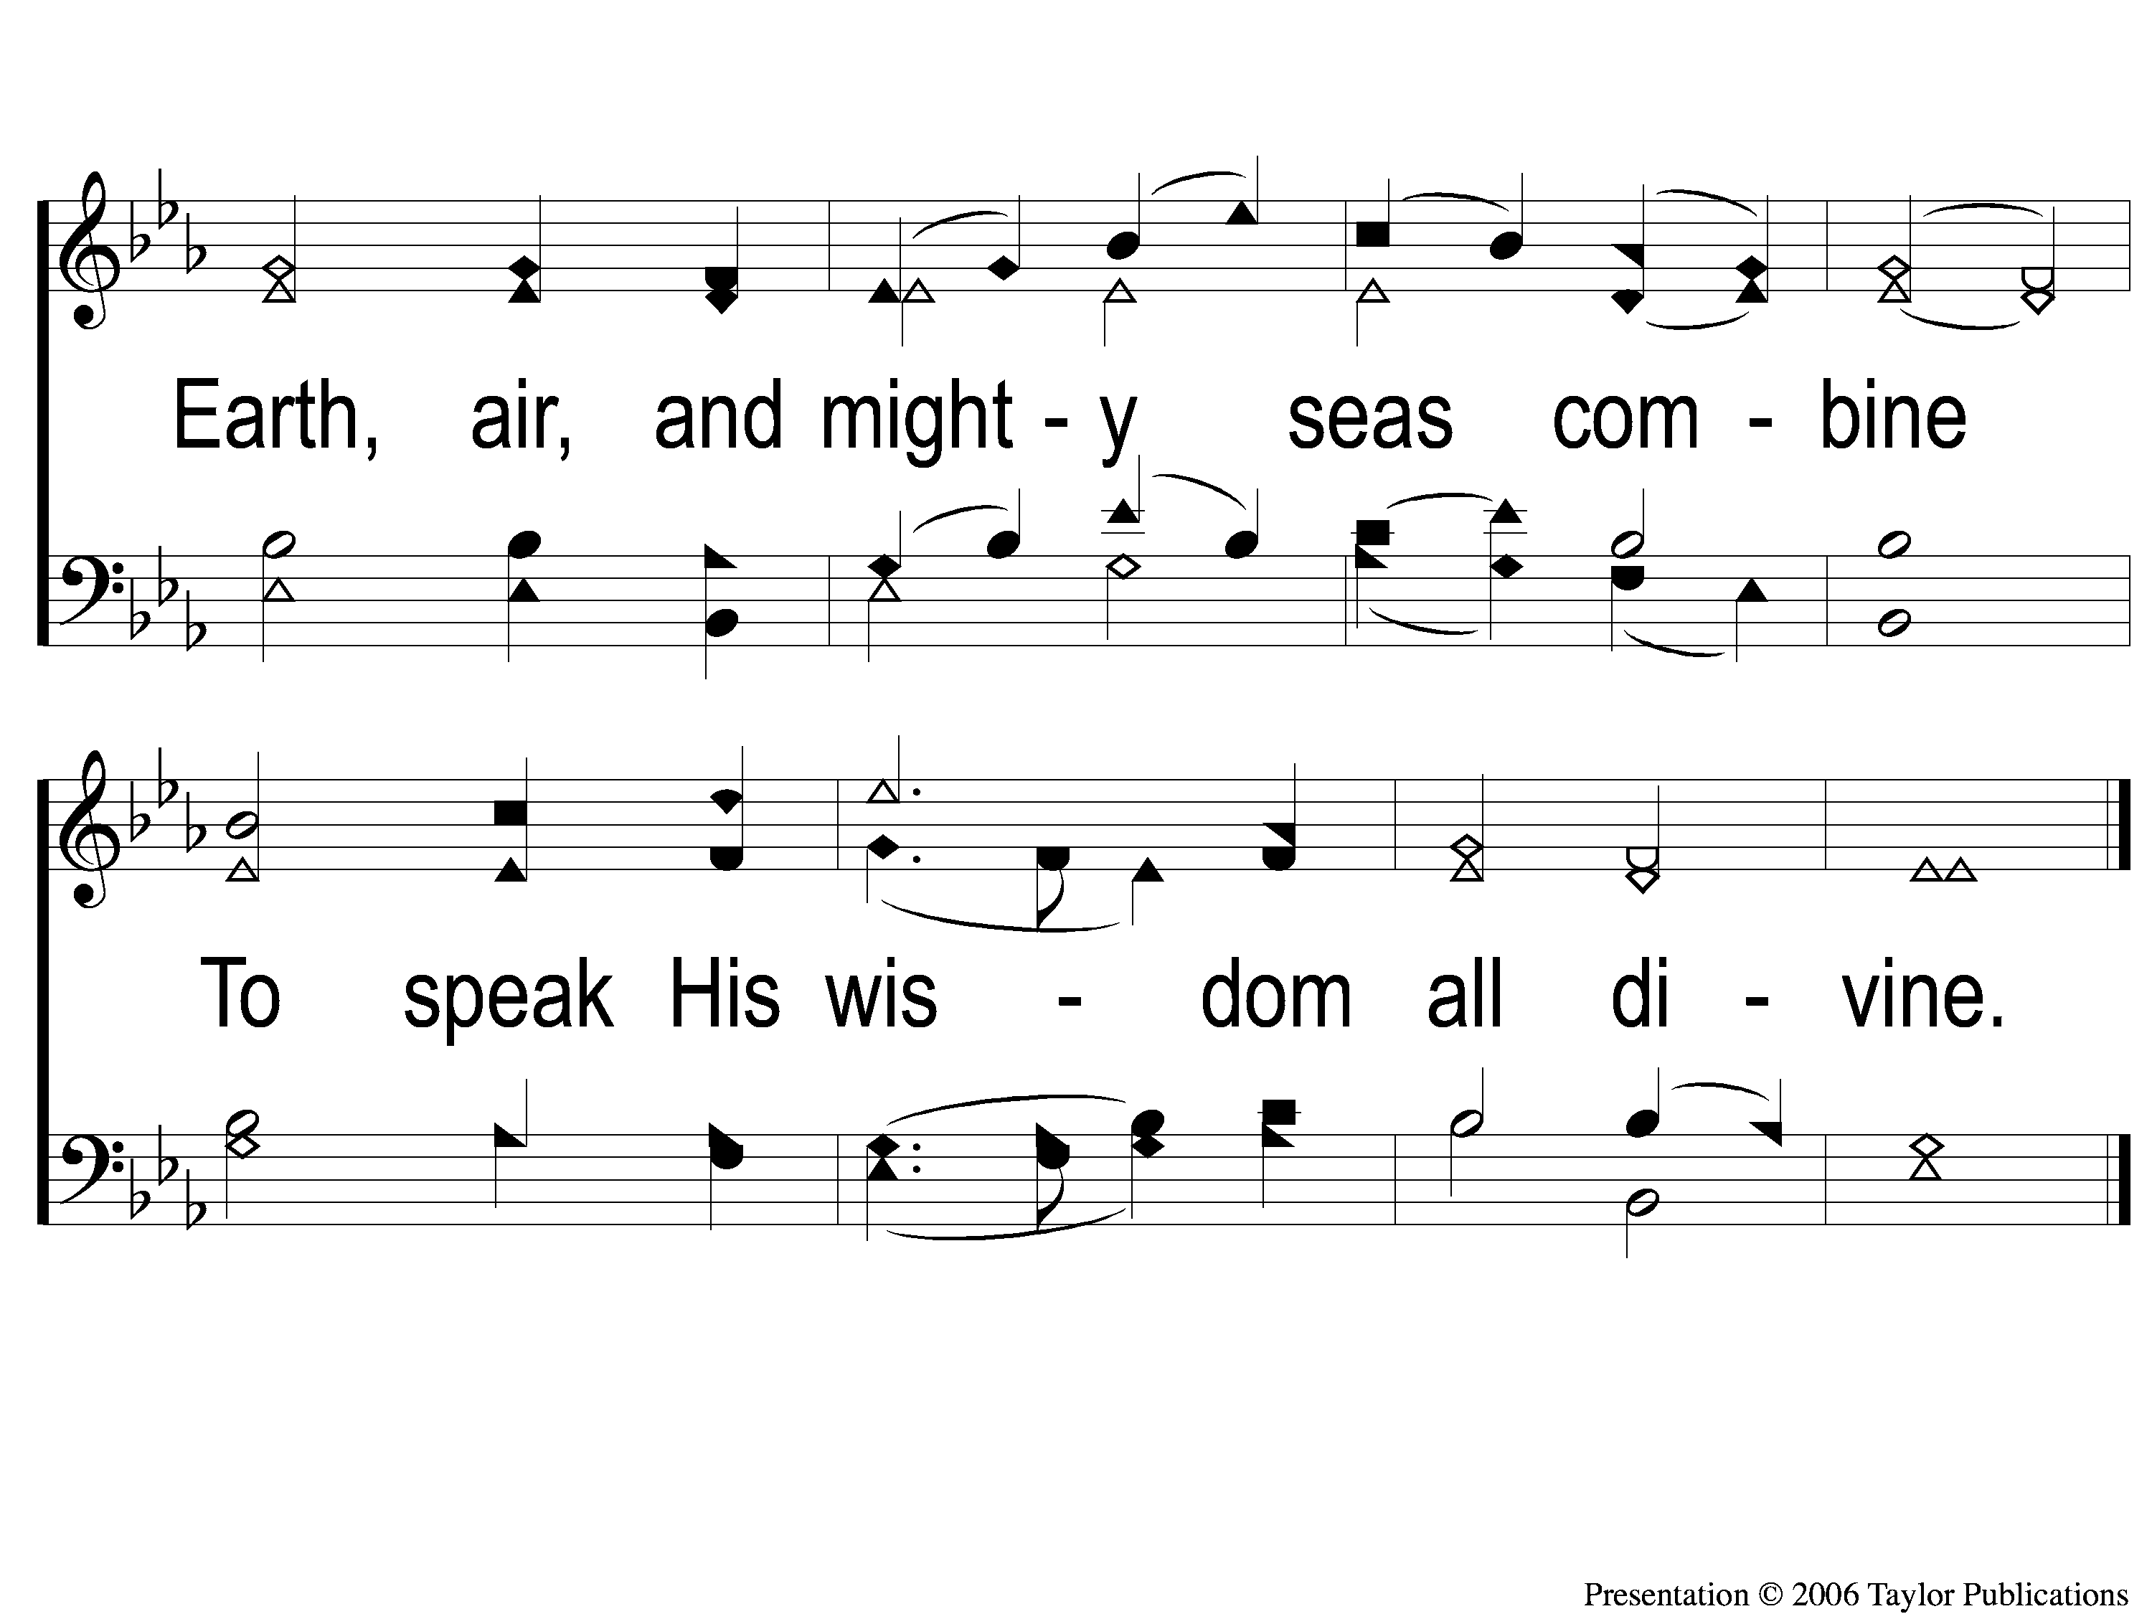
3-2 Awake My Tongue Thy Tribute Bring
Awake, My Tongue, Thy Tribute Bring
161

Slide 7
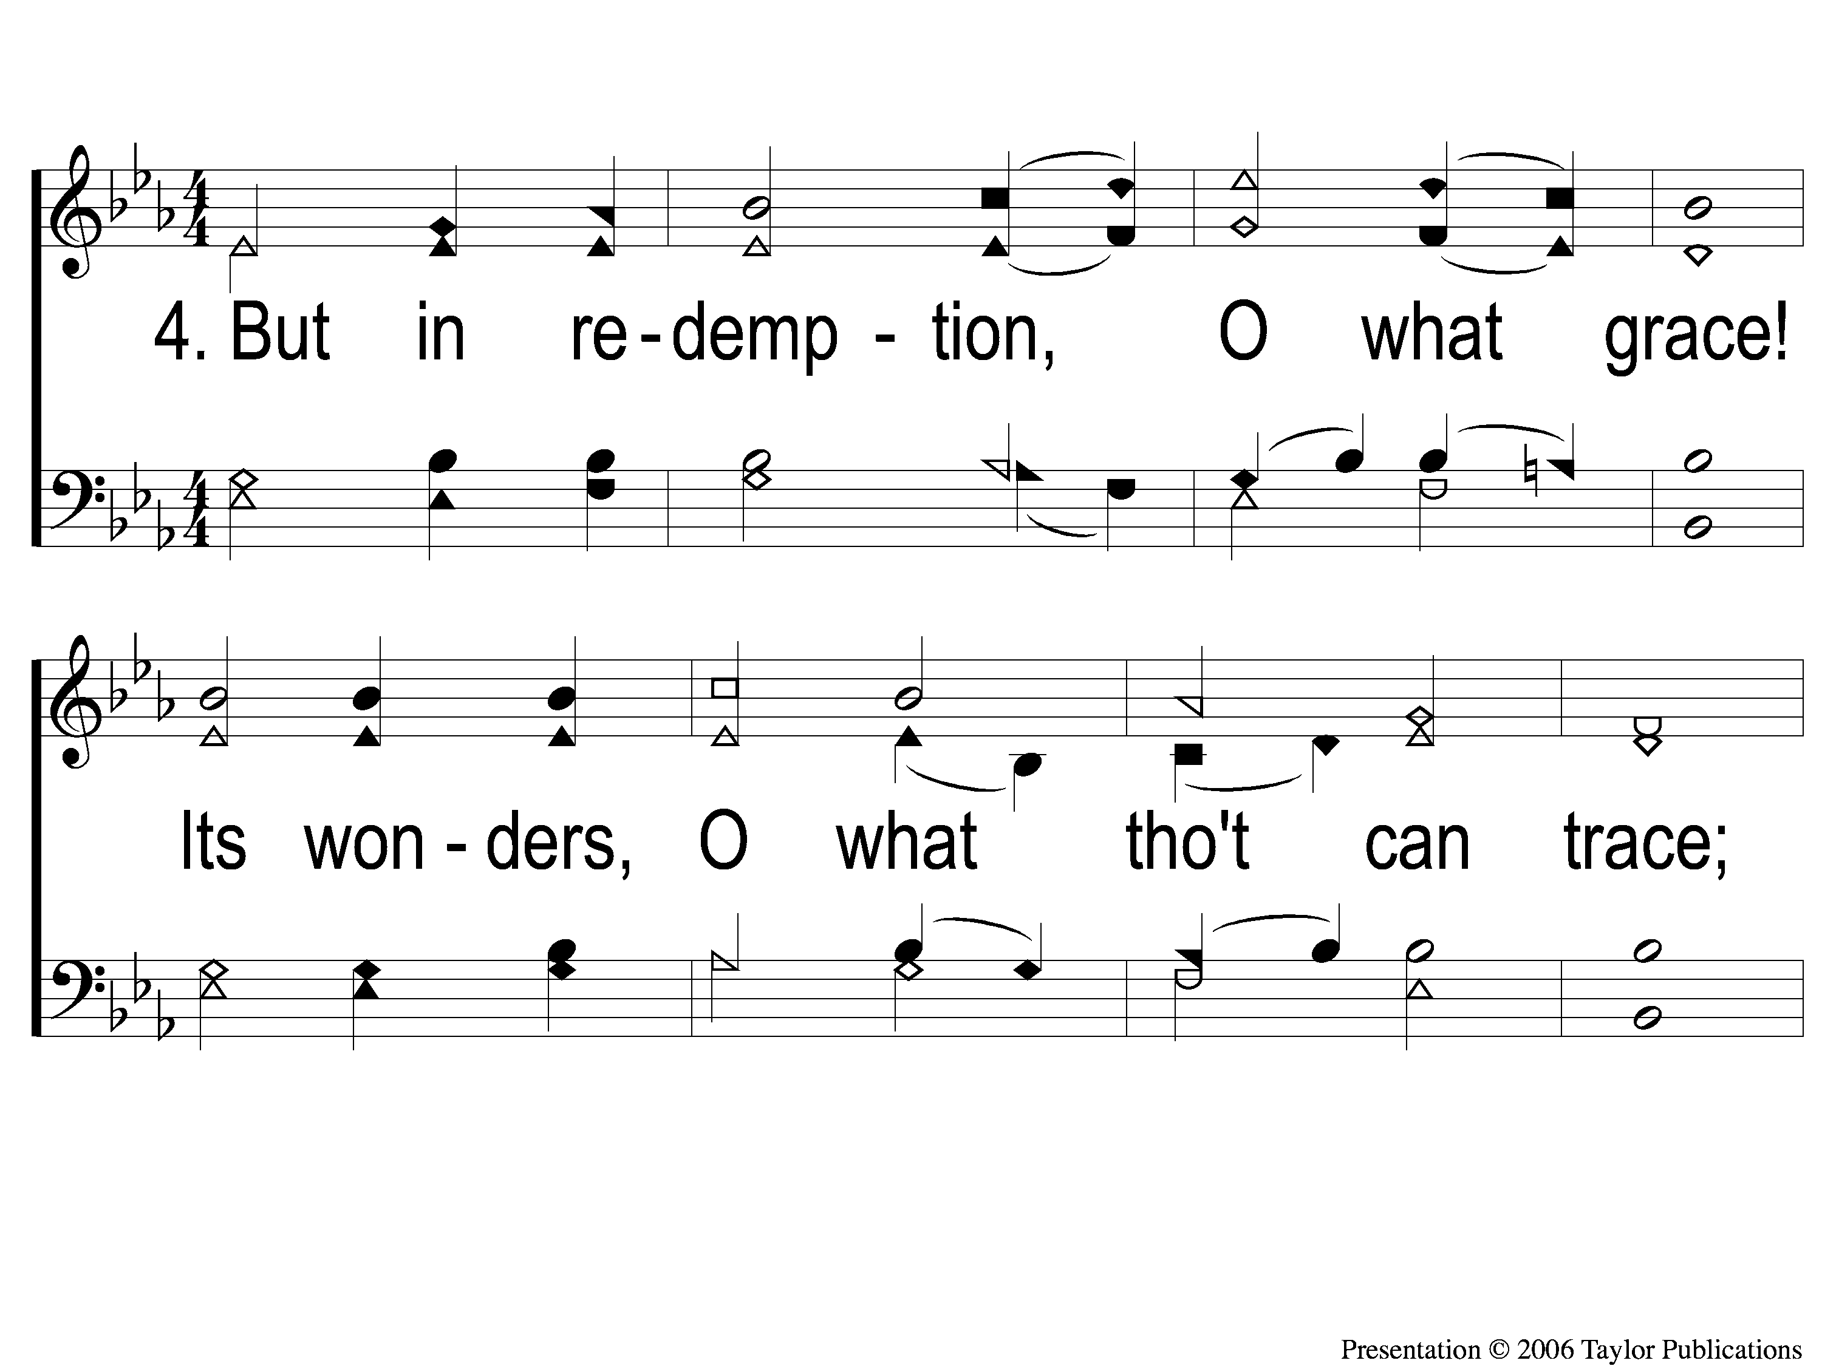
4-1 Awake My Tongue Thy Tribute Bring
Awake, My Tongue, Thy Tribute Bring
161

Slide 8
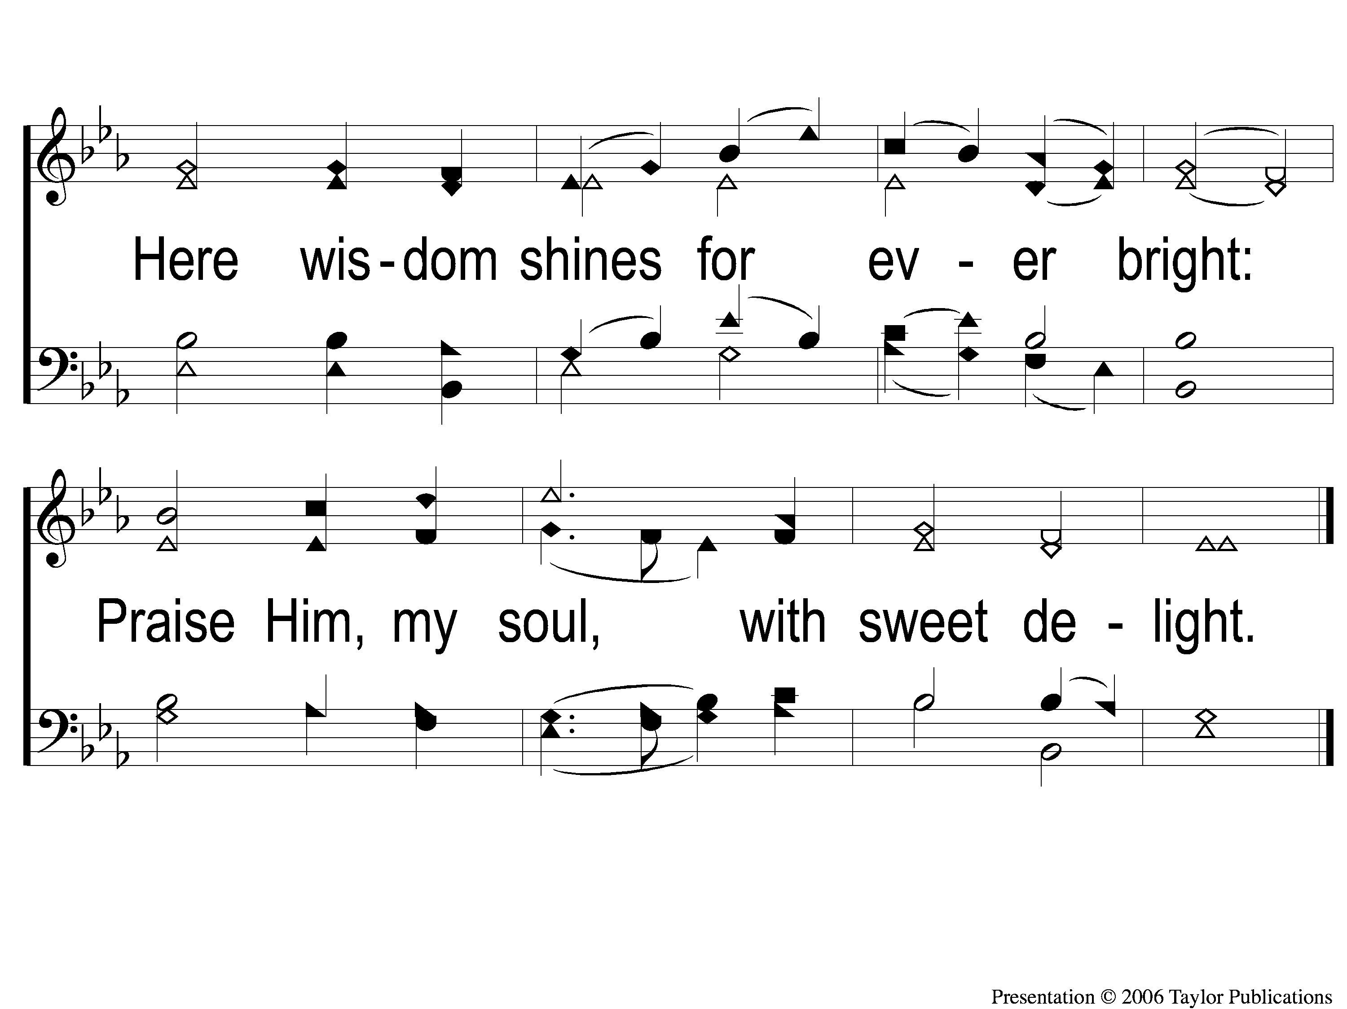
4-2 Awake My Tongue Thy Tribute Bring
Awake, My Tongue, Thy Tribute Bring
161

